Slide 1
Deliverable Phase 3: Portfolio for DLBCSPJWD01 Filip Prahov Matriculation: 9211057
GitHub Repo link:
https://github.com/FilipPrahov/pjwd_app

Slide 2
Purpose of the Web App
Application: Simple Warehouse System (SWS) for a chain of bookstores
The purpose of SWS is to keep track of company’s item stocks in different warehouses (WH) across the country. SWS is hosted on a mainframe in the company HQ, and every WH of the company has access to it via web app. The main actors and the operations they can execute in the system are:
WH manager(s):
Can display list of items and quantities which are currently in the WH;
Can create ‘Delivery Receipt’ which increments the inventory of the WH with the quantities of received items;
Can create ‘Shipment Order’ which decrements the inventory of the WH with the quantities of shipped out items;
HQ accountant(s):
Can create new Item Card;
Can list total current inventory (all WHs) to aid procurement with orders to suppliers;

Slide 3
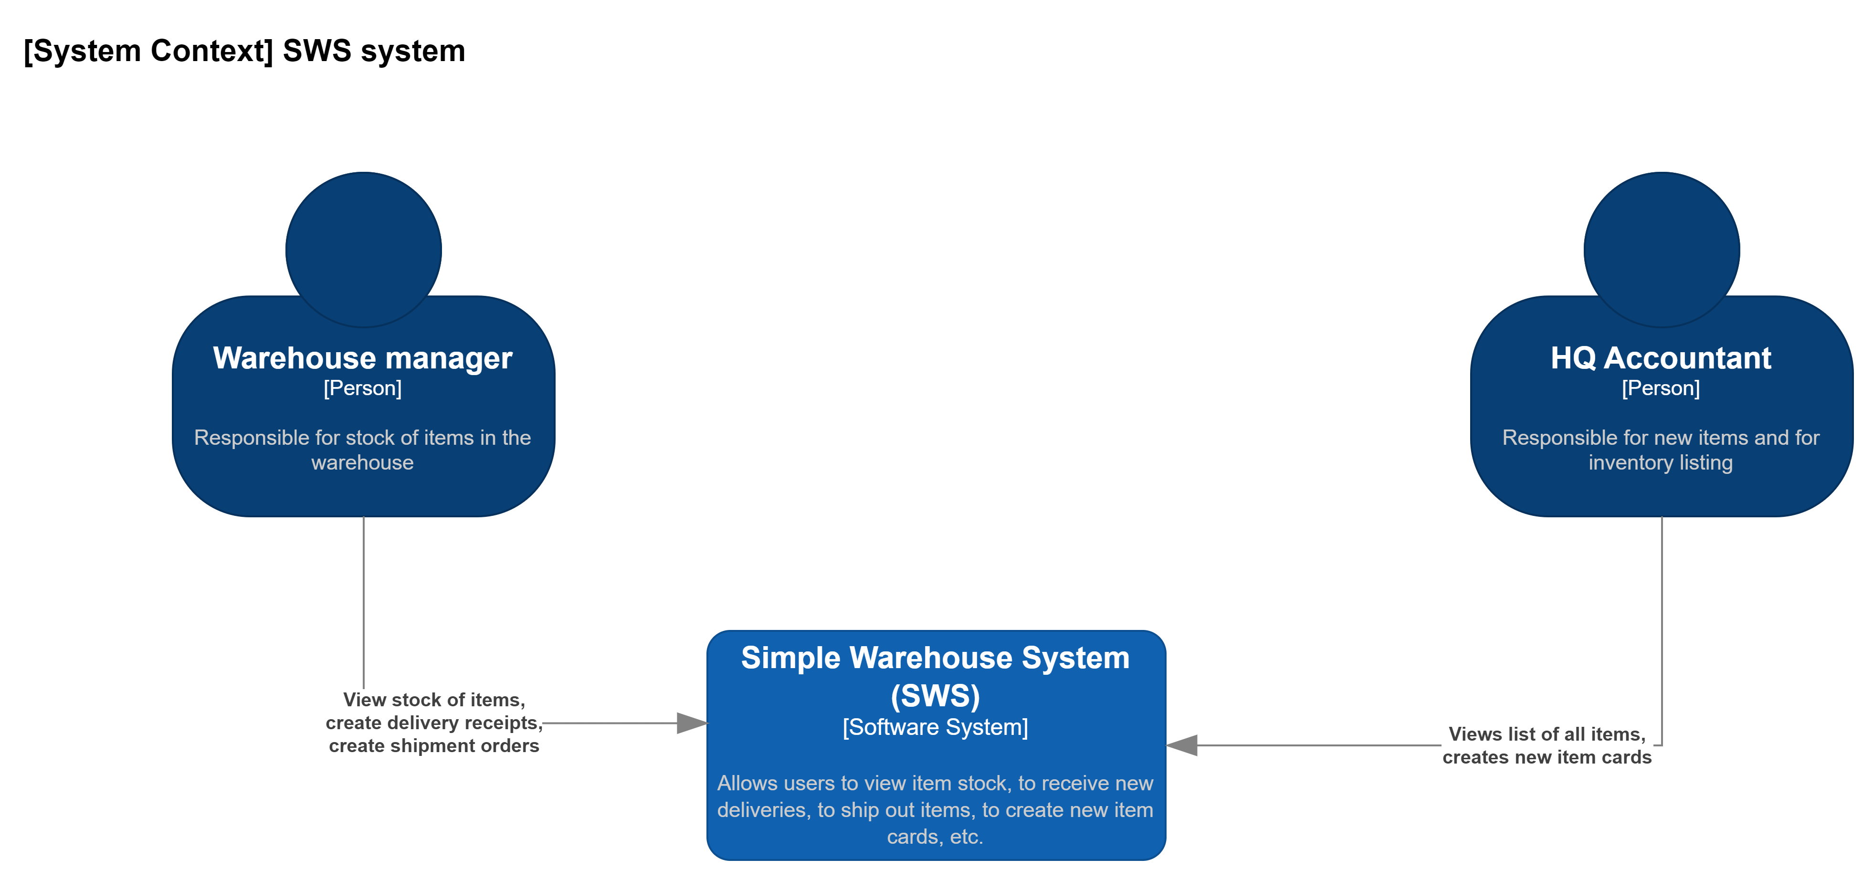
Architecture Diagram (using C4 model)

Slide 4
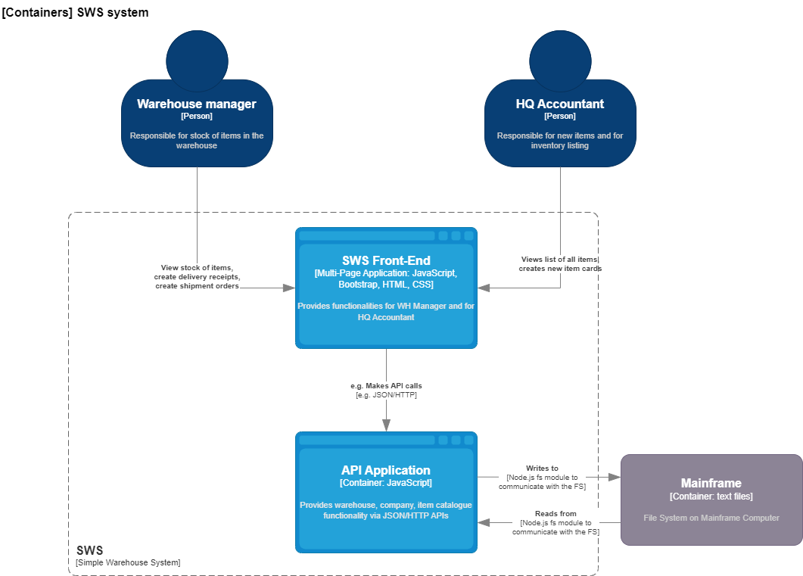
Architecture Diagram (using C4 model)

Slide 5
Overview of technology choices
Front-end:
HTML
CSS
Bootstrap 5
JavaScript
Back-end:
Node.js

Slide 6
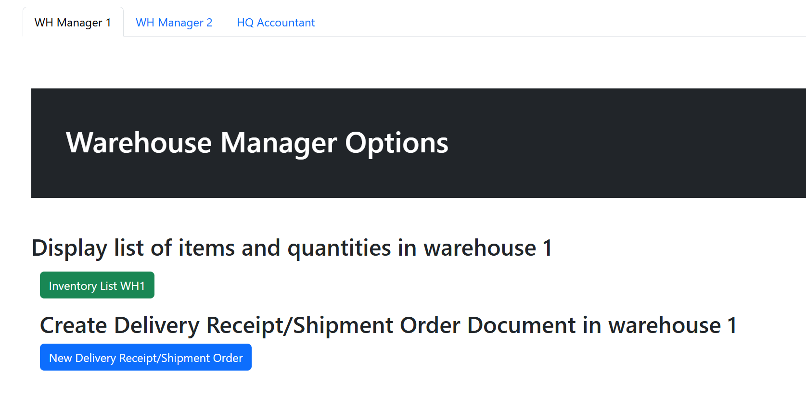
WH manager tab functionalities
WH manager lands on his/her tab after login
WH manager 2 has the same functionalities but is linked to WH2
The current inventory list is displayed On click
A modal for registering Delivery Receipt or Shipment Order is opened on click

Slide 7
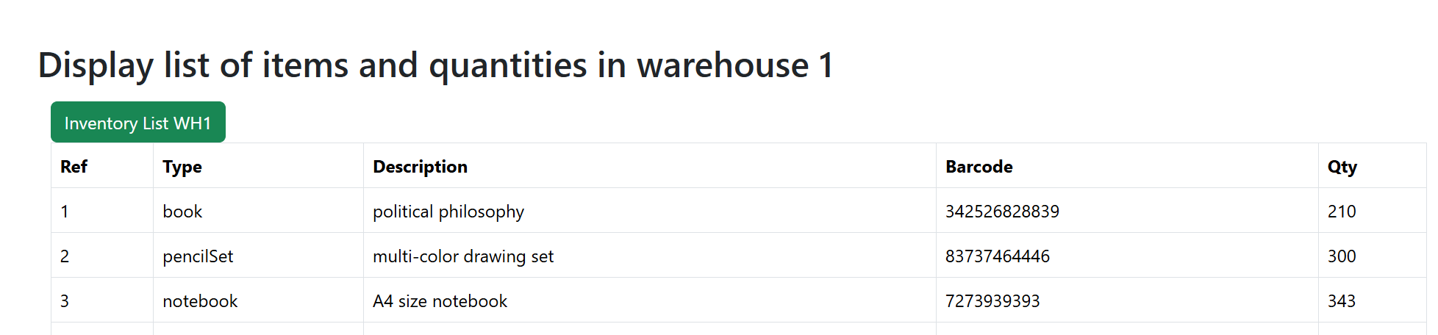
WH manager tab functionalities (con’d)
Second click on the button hides the listing
The listing provides the common attributes of the items and their quantity in the warehouse

Slide 8
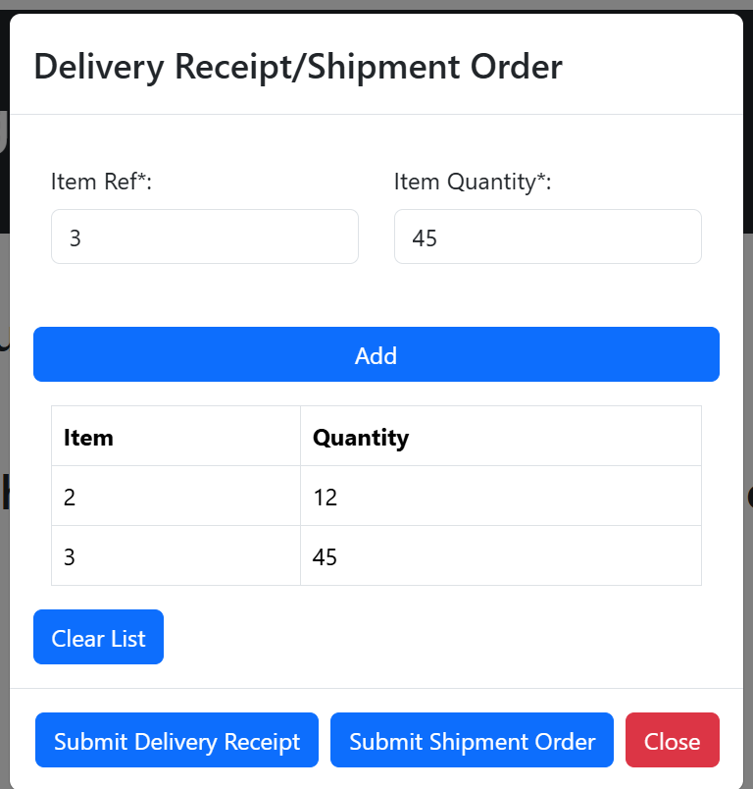
WH manager tab functionalities (con’d)
User enters item ref and quantity and clicks button Add to add the item to the temp list below
If user makes a mistake while entering the list, he/she can click “Clear list” which clears the temp list
User clicks corresponding button depending whether it is a Delivery Receipt or Shipment Order
User clicks “Close” button to close the modal

Slide 9
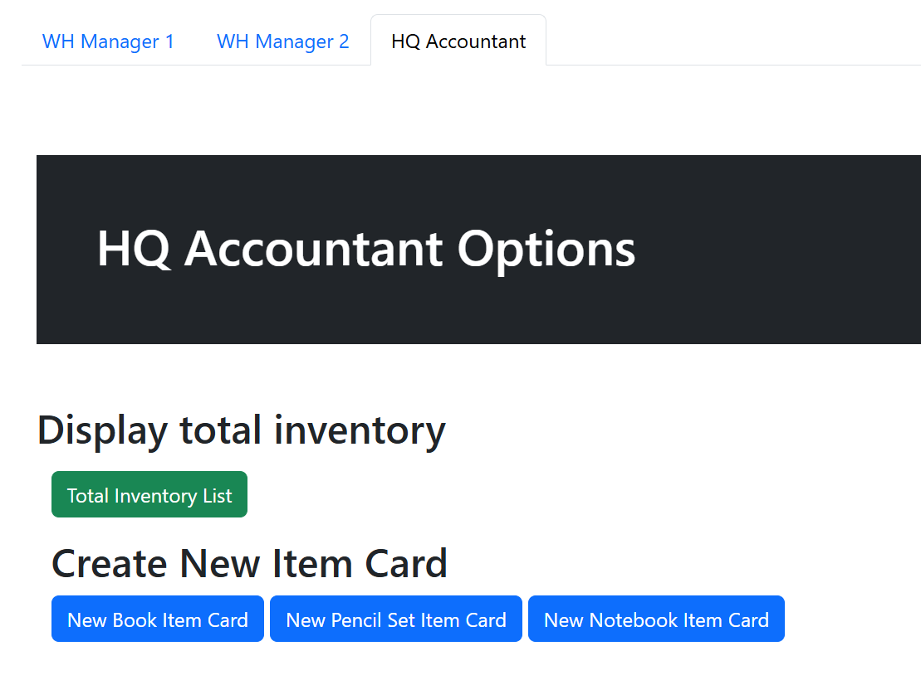
WH manager tab functionalities (con’d)
The Accountant has
different functionalities
Accountant can list the total inventory in all WHs which helps procurement to decide for future orders to suppliers
Accountant can create item card for new items on the pre-defined item types

Slide 10
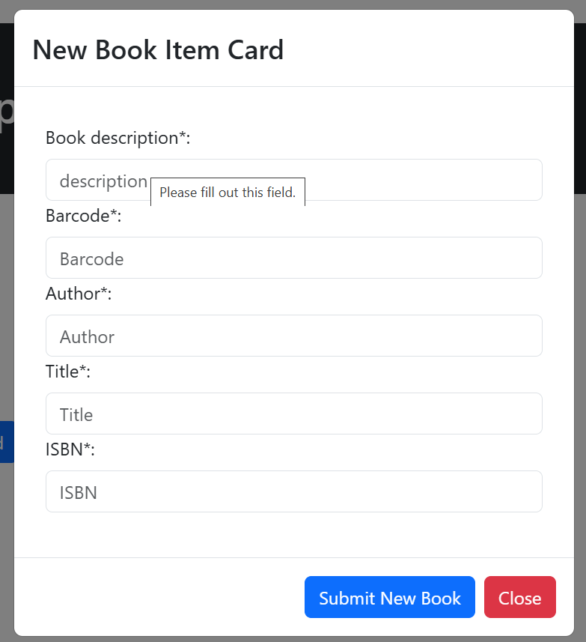
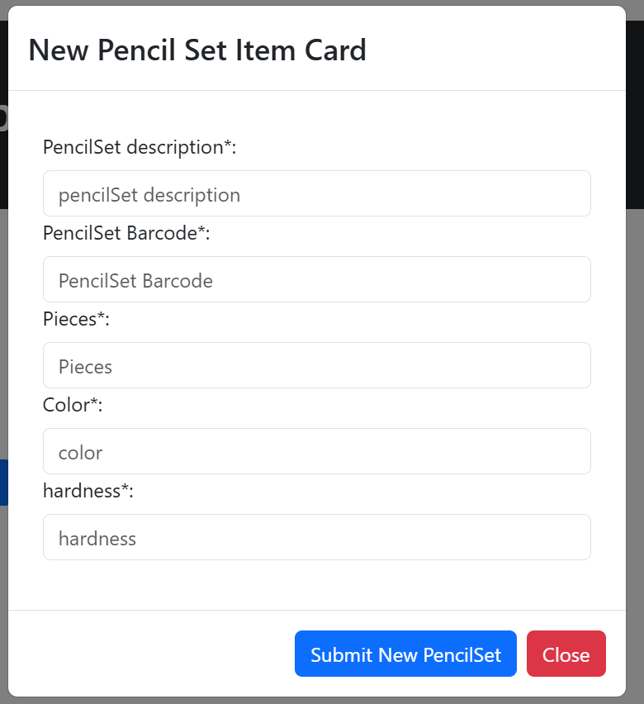
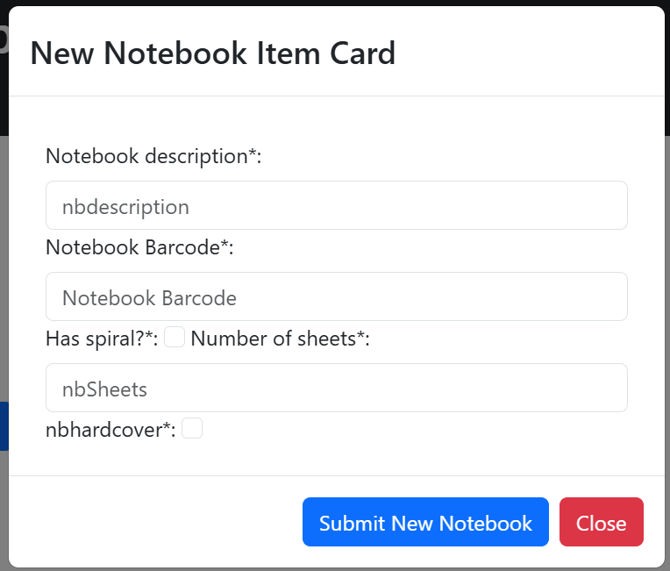
WH manager tab functionalities (con’d)

Slide 11
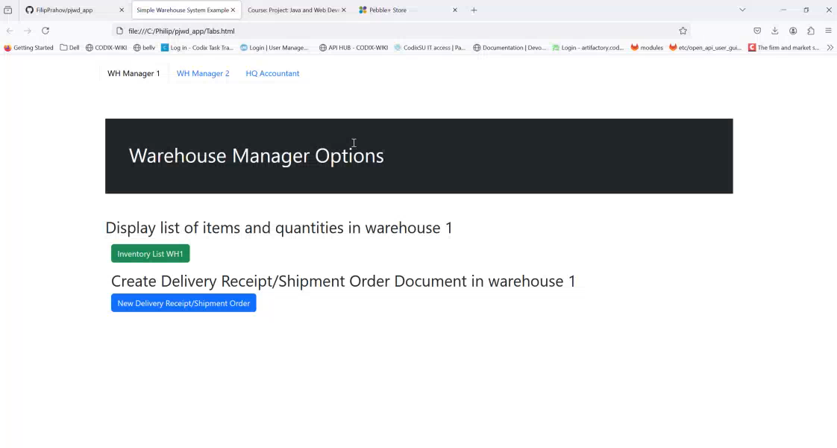
What I changed and screencast
I kept the architecture and technology choices for both FE and BE as initially proposed
However, I limited the functionality – did not implement the accountant listing inventory in one particular warehouse
I added the option to initialize the Company with 2 empty warehouses, and empty item catalogue
Screencast from the app:

